Slide 1

Reviewer on
Local Government Law
SC cases 2016, 2017, 2018, 2019,
2020, 2021, 2022, 2023 and 2024
Alberto C. Agra
January 20, 2025

Slide 2
Flow
(1) Nature of LGUs
(2) Local Autonomy
(3) Powers of LGUs
(4) Fiscal Autonomy
(5) Local Legislation
(6) Public Accountability
(8) People’s Participation
(7) Liability

Slide 3
1. Nature of LGUs
Local Governments or Local Government Units are:
  Territorial and Political Subdivisions
  Public Corporations
  Municipal Corporations Proper
  Administrative Agencies
  Public Offices
“Ours is still a unitary form of government, not a federal state.”
LGUs do not have constitutionally-protected sovereignty. LGUs have no claim against the State.
LGUs are not “Imperium in Imperio” (empires within an empire), not Independent Sub-National Units

Slide 4
1. Nature of LGUs
LGUs are “not impenetrable states”; under supervision of President and may be held accountable; President has general supervision over provinces, HUCs, and independent component cities
5 Levels/ Kinds (Autonomous Regions [only BARMM incorporated], Provinces, Cities [CC, ICC and HUCs (not under provincial oversight)], Municipalities and Barangays)
Territorial: delimited by law, not by exercise of jurisdiction; Baguio City, under its Charter, is exempted from coverage of IPRA
Sources of Powers: Constitution, Law and Charter (No inherent, but have broad, powers; not self-government)

Slide 5
1. Nature of LGUs
Separation of Powers (Legislative, not constitutional)
Corporate Succession (Contractual Obligations); cannot be rescinded unilaterally by next Administration
LGU Dual Capacities:
  Governmental/ Public (e.g. repair of municipal roads, issuance of business permits)
  Proprietary/ Private (e.g. waterworks, cemetery, markets) [distinction relevant for delegation purposes]
Dual Agency: LGUs as Agents of the State (in exercise of government powers) and People/Community (in exercise of proprietary powers)

Slide 6
1. Nature of LGUs: Creation
Legislative Act: Charter (Not by Executive Branch but becomes de jure if State-recognized and No Judicial Dissolution; President can merge administrative regions); congressional, not executive, authority to set requirements for specific levels of LGUs other than what is stated in LGC; BARMM, through BARMM Transition Authority (BTA) and Chief Minister, can create municipalities per BARMM Organic Act since legislative and executive powers vested in BTA during transition
Criteria: Population, Land Area (includes DENR-managed forestlands) and (or) Income (internal [if M to CC] or external); liberal construction
Distinct Personality: Municipality when converted to a City
Failure to identify Seat of Government not fatal
Assail Existence: Quo Warranto (5 years)

Slide 7
1. Nature of LGUs: Creation
Plebiscite
electorate - plurality and economic dislocation; directly affected (including voters of original municipality, not just voters of new municipalities)
upgrade and downgrade
boundary disputes present a prejudicial question
plebiscite protest cases – Comelec
approval in a plebiscite ipso facto/ is the operative act which creates and segregates the province; if election of officials of newly-created province is not feasible, the incumbent vice-governor serves as acting governor; hold-over applies only if there is no express or implied legislative intent to the contrary
conversion to HUC is substantial alteration of boundaries; substantial alteration requires a plebiscite without which, area remains with the Republic
Sulu no longer part of BARMM since its voters did not ratify the BARMM Organic Act

Slide 8
1. Nature of LGUs: Creation
Boundary Disputes
due weight should be given to the contemporaneous interpretation of the courts and other lawful authorities and by the population at large residing therein; maps published by authority of law may be referred to as evidence; Unrebutted testimony of Mayor greater weight than residents
Survey plan repeatedly recognized by duly constituted authorities prevails over a map prepared by a party to case
Preponderant evidence needed to establish if area falls within new boundary line
If between 2 HUCs, joint referral to councils of both HUCs; if no settlement, certification will be issued

Slide 9
1. Nature of LGUs
B
P/C/M/B | ARMM | CAR | MMDA
AA; LGU | AA; LGU | AA | AA
Admin Autonomy | Political Autonomy | Not Enjoy Autonomy | Not Enjoy Autonomy
Police & Legislative Power | Police & Legislative Power | No Police Power; No Legislative | No Police Power; No Legislative
Presidential Supervision | Presidential Supervision | Presidential Control | Presidential Control
Amend by Law | Amend by Law + Plebiscite | Amend by Pres./ Law | Amend by Law

Slide 10
2. Local Autonomy
“means a more responsive and accountable local government structure instituted through a system of decentralization” (relates to dual capacity/ agency)
“does not contemplate making mini-states out of LGUs”
“LGUs xxx form part of the whole” (unitary)
“Regional autonomy is the degree of self-determination exercised by the LGU vis-à-vis the central government.”
“Autonomy is either decentralization of administration or decentralization of power.”
“Decentralization comes in two forms: deconcentration and devolution.”
“Decentralization simply means the devolution of national administration, not power, to LGUs.”

Slide 11
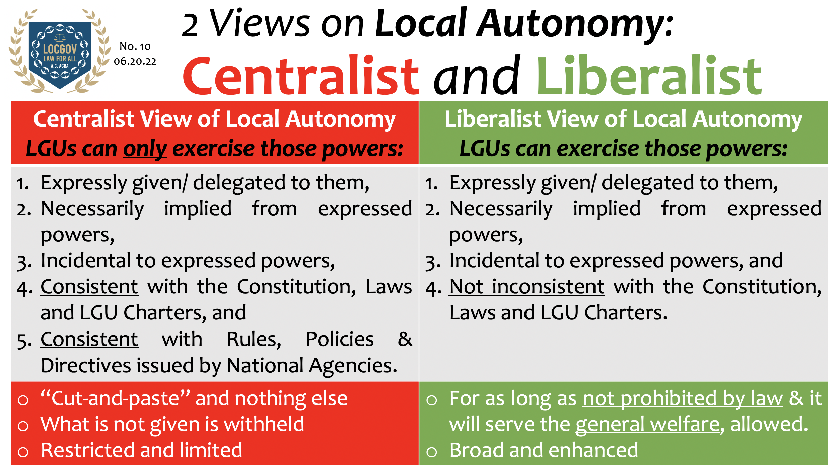

Slide 12
2. Local Autonomy
Decentralization of Administration | Decentralization of Power
Delegation of Administrative Powers – Regulatory Powers and Basic Services | Abdication of Political Power
Relieves State from Burden of Managing Local Affairs | Free to Chart own Destiny
Executive Supervision | Executive Supervision Minimal State Intervention
Accountability to Central Government | Accountability to the Constituency; Self-Immolation
Provinces, Cities, Municipalities and Barangays | Autonomous Regions

Slide 13
2. Local Autonomy
Bangsamoro Autonomous Region in Muslim Mindanao
BARMM Organic Act (BOA) constitutional
Not a separate state
Autonomy limited to internal governance
Limited by national policies and standards (1991 LGC)
Sulu excluded since not vote for ratification of BOA
Congress can provide for BARMM Parliament (fusion of executive and legislative powers)

Slide 14
2. Local Autonomy
Administrative Decentralization | Political Decentralization
Deconcentration | Devolution
Transfer of Functions: National to Regional | Transfer of Powers: Central to LGUs
Administrative | Powers, Responsibilities and Resources
LGC: Section 528 | LGC: Section 17

Slide 15
2. Devolution
Components:
Delivery of Basic Services
Exercise of Regulatory Powers
Personnel
Assets, Equipment and Property
  Administrative autonomy involves devolution subject to limitations – national policies, standards and laws
  Exempted from devolution are nationally-funded projects, facilities and programs
Devolution is power-specific. Only those powers enumerated by law are transferred to LGUs.
Those not expressly transferred are retained by the NGAs/AAs.
Political Question/ Congressional Plenary Power (devolved and to recentralize)
Source: 1991 LGC and other laws
Full devolution due to National Tax Allotment (EO 138-2021)

Slide 16
2. Devolution
Basic Services
Regulatory Powers
School Buildings (DEPED)
Hospitals (DOH), not national hospitals
Socialized Housing (NHA)
Agricultural Extension (DA)
Day-care Centers (DSWD)
Community-based Forestry Projects (DENR)
Approval of Subdivision Plans (HLURB), not of national significance
Inspection to check compliance with noise standards (Nat’l Pollution Control Comm.)
Enforcement of Environmental Laws (DENR), not regulation of pesticides, (Fertilizer and Pesticide Authority)
Franchising of Tricycles (LTFRB), not PUBs/ PUJs, not LTO
Inspection of Meat Products (DA)
Not grant of franchise for cable TV operations (NTC)
Not control and regulation of the use of ground water (NWRB)
Enforcement of National Building Code (DPWH) (impose stricter requirements under police power)

Slide 17
2. Local Autonomy
Areas | Delegation | Devolution
What is transferred? | State Powers | Power of NGA
Basis of Transfer | Law; Congress | Congress (or President)
Effectivity of Transfer | Immediate; law effectivity | NGA facilitates actual transfer
Examples | Police Power, Tax, Expro, Local Legis | DSWD; DENR; HLURB; LTFRB

Slide 18
2. Local Autonomy
Congress retains control of the local government units although in significantly reduced degree
The Constitution confines the President‘s power over the LGUs to one of general supervision. This provision has been interpreted to exclude the power of control.
cannot be “blunted by undue interference by the national government in purely local affairs” (PDAF)
The President can only interfere in the affairs and activities of a local government unit if he or she finds that the latter has acted contrary to law; DILG can require full disclosure of budgets and expenses of IRA since required by law
“The matter being peculiarly local in nature, the municipal council alone is in a better position xxx” (Principle of Subsidiarity); superior competence in local matters; purely local affairs best resolved by the officials and inhabitants of such political units; especially if so authorized by law, and no law is violated and when LGU has discretion as in zoning regulations (“photobomber” building)

Slide 19
Hierarchy/ Relationship
Direct Supervision
President
Indirect Supervision
AR
Prov
Prov
IC
CC/CM
CC/CM
HUC/IC
M-MM
B a r a n g a y s

Slide 20
2. Local Autonomy
Supervision
Overseeing
Ensure that supervised unit follows law/ rules
Allows interference if supervised unit acted contrary to law
Over actor (discipline) and act (declare illegal)
There must be a law, otherwise, control/ undue delegation/ violate local autonomy (Yes - DOJ, DBM; None - OP, DILG, DENR)
Only involves questions of law (i.e., declare act legal or illegal/ ultra vires), not wisdom/ questions of fact; cannot declare acts against general welfare, excessive, confiscatory
Control
Lays down rules in doing of an act
Impose limitations when there is none imposed by law
Preempts action/ discretion
Decide for subordinate
Substitute/ change decision
Alter wisdom, law-conforming judgment or exercise of discretion
Discretion to order act undone or re-done
Prescribe manner by which act is done

Slide 21
2. Local Autonomy
Executive Supervision
Review of Executive Orders and Ordinances (i.e., can declare illegal)
Disciplinary Action
Preventive Suspension
Integration of Plans/ Zoning
Boundary Disputes (city or municipality, not RTC at 1st instance, over inter-barangay disputes, appeal to RTC; consider interpretation of population and maps)
Approves Leaves/ Resignation
Fills up vacancies in council
Augmentation of Basic Services
Legislative Control
Structure
Elective and Appointive Officials
Totality of Powers
Qualifications
Manner of Selection
Taxes
Nat’l Tax Allotment/ Nat’l Wealth
Creation
Public Land, either public or private (plaza cannot be converted to a commercial center); owned in its governmental capacity; if no proof that LG corporate funds used; alienable and disposable land can be established by any positive act of Government other than a presidential proclamation

Slide 22
SK Reform Act of 2015 (2022)
SK:
SK Officials not related to national and local elective officials
Develop programs such as student stipends, food, and book and transportation to prevent incidence of out of youth; sports and wellness projects; skills training, summer employment, on-the-job employment, and livelihood assistance; promotion of agriculture, fishery, and forestry enterprises; environment protection; capacity building for grassroots organizations; and program to address “context-specific and intersectional vulnerabilities
Formulate Comprehensive Barangay Youth Development Plan
Comply with the government’s accounting and auditing rules and regulations set by the DBM and COA
Adopt internal rules and procedures
Set the schedule of their regular meetings

Slide 23
2. Local Autonomy
“Paradoxically, local governments are still subject to regulation, however limited, for the purpose of enhancing self-government.”
National concern “cannot be subjected to fragmented concepts of management policies where xxx local government units exercise exclusive dominion over specific portions xxx” (National Dimension Rule; Integration/ Centralization)
“The Local Government Code xxx directs executive officials and employees of the municipality to faithfully discharge their duties and functions as provided by law.”
Grants LGUs power to reorganize and streamline bureaucracy, adopt organization development program
LGU no power over program funded under GAA even if it involves delivery of basic services in LGU

Slide 24
2. Local Autonomy:
Conflict Resolution: National Prevails
DENR (forestry laws)
FPA (regulation of pesticides)
LTO (issuance of driver’s license)
LTFRB (franchising of jeepneys/ buses)
HLURB (national projects)
COA (additional allowance)
NTC (cable TV franchise)
DAR (conversion)
GAB (jai alai frontons)
LLDA (fishpens, dumpsite)
BCDA (creation of Zone)
PAGCOR (casinos)
PCSO (lotto outlets)
PRC (profession)
MMDA (traffic management, single ticketing system, number coding-scheme for buses is within rule-making authority)
LWUA (water districts)
DPWH (city engineer)
CSC (dismissal)
OP (discipline)
NWRB (control and regulation of the use of ground water)

Slide 25
2. Local Autonomy:
Conflict Resolution: LGU Prevails
DENR (ordinance)
DBM (allowance for judges, budget officer)
COA (RATA)
DENR (oil depots)
DOJ (tax ordinance)
Regulate telecoms tower (NTC)
Higher LGU (review)
DAR (reclassify, expropriation)
DILG (barangay liga)
OP (IRA)
DOF (RPC/ LGC)
BOI (6-year exemption)
MMDA (1-way streets, encroachments and alleys, subdivision, dumpsite; terminals; review ordinances)
NAPOCOR (voltage cables)
DSWD (devolved personnel)
Congress (IRA, amend Organic Act)
Province relative to HUC (rotating appointment for water districts)
Zoning/ “Photobomber” building

Slide 26
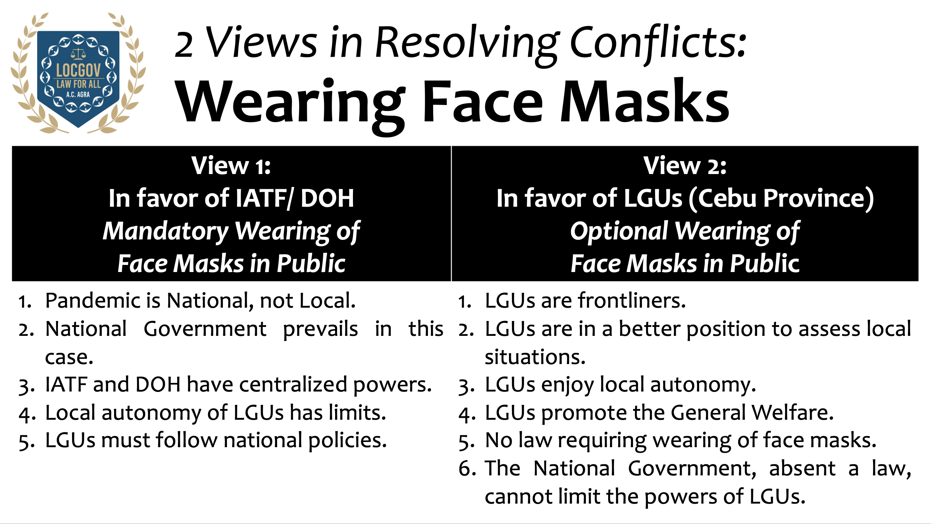

Slide 27
2. Local Autonomy
In favor of NGA/GOCC/GI if:
Integration
Centralization
Avoid fragmentation
Preemption allowed
National/ Broader Interest
Mandate exclusive under Charter/ law
Implied repeals not favored
Instrumentalities of the State
National or cross-boundary concerns are best addressed by NGAs/ GOCCs
National Dimension Rule
In favor of LGU if:
Local autonomy
Local concern/ issue
‘Isolated’ issue
General Welfare
No law will be violated
As agents of communities
Amounted to executive control
Express repeal; categorical/ clear implied repeal
Rules of interpretation
Beyond powers of NGA/ GOCC
Local concerns are best addressed by LGUs (Principles of Subsidiarity and Stewardship)
Local/ Municipal Dimension Rule
Main/ Default Rule: Follow law.

Slide 28
3. Powers of LGUs
LGUs do not possess inherent powers but have broad powers because of local autonomy
Unlike other Administrative Agencies, LGUs can prohibit an activity when there is no law which prohibits
LGUs have constitutional and statutory powers
Powers interpreted in favor of LGUs (local autonomy; fiscal autonomy; local over national; lower over higher)
Liberal (devolution, fiscal autonomy) and strict (police power, taxation and eminent domain) interpretation

Slide 29
3.1 Police Power
Delegated to all LGUs
Definition: Authority to impose burdens on private property/ restrain and regulate use of liberty and property
Basis: General Welfare Clause is “the delegation in statutory form of the police power of the State to LGUs”
Legislative: Police power exercised mainly through an ordinance
Reason for Delegation: Dual Agency
Hierarchy: The general welfare in terms of economic benefits cannot override the very basic rights to life, security and safety of the people

Slide 30
3.1 Police Power
Scope: not give LGU invincible authority (cannot take private property); not over- (greater burden than necessary) or under-inclusiveness (ban on aerial spraying since the occurrence of pesticide drift results from any mode of pesticide application)
2 Requisites: (1) Lawful Subject (equal protection; public interest requires interference) and (2) Lawful Method (due process; reasonable means to achieve purpose)
2 Tests: Rational Relationship (governmental interest and means) and Strict Scrutiny (compelling, not just substantial (2016) – e.g. juvenile safety in curfew)
2 Branches: General Legislative – what law expressly allows (e.g. abate nuisance, business permit) and Police Power Proper – based on principles/ policies (e.g. issue cease and desist orders)

Slide 31
3.1 Police Power
Precautionary principle: relevant if there is concurrence of three elements, namely: (scientific) uncertainty, threat of environmental damage and serious or irreversible harm. In situations where the threat is relatively certain, or ·that the causal link between an action and environmental damage can be established, or the probability of occurrence can be calculated, only preventive, not precautionary measures, may be taken; application against aerial spraying cannot be solely based on a fact-finding study which is not a scientific study (not meant to apply to all environmental cases)

Slide 32
3.1 Police Power
Invalid
Prohibit setting up of PCSO lotto outlets
Regulate Jai Alai frontons
Regulate professions regulated by PRC
Operate dumpsites in violation of environmental standards
Issue drivers’ licenses
Register motor vehicles
Regulate or Tax jueteng
Prohibit the operation or establishment of massage parlors, beerhouses, motels, etc. in a certain area/ road or require conversion to other businesses without just compensation

Slide 33
3.1 Police Power
Order the closure of a bank not performing illegal activities for non-payment of taxes
Padlocking of an establishment without according owner due process
Allow 3 cockpits
Declare a bus terminal a nuisance per se and order its closure
Declare a thing a nuisance per accidens
Demolition of a building without court order
Declare a gas station as nuisance per se
Ban Rallies
Lease of public plaza
Wanton denial of issuance of mayor’s permit

Slide 34
3.1 Police Power
Mayor not remove oil terminals per ordinance
Mayor not release funds when appropriations approved
Demolish a wall or build a fence with a setback for the purpose of allowing the general public to use the property of the private owner for free depriving the owner of exclusive use
Mayor ordering demolition of structures violating National Building Code (Building Official is the one authorized)
Order the summary demolition or eviction if it was not shown that the structures are in danger areas or public areas; or when the occupants are neither new squatters nor professional squatters nor members of squatting syndicates as defined in RA No. 7279
Order a donation of delineated road without just compensation
Demand compliance within an unreasonable period under pain of penalty

Slide 35
3.1 Police Power
Valid
Issue a zoning ordinance
Prohibit the expansion of a hospital based on the approved a new zoning ordinance
Restrict the use of property since contractual restrictions on the use of property could not prevail over the reasonable exercise of police power
Declare a thing a nuisance per se
Demolish a hotel declared as a nuisance per accidens since property rights can be subject to restraints in order to fulfill objectives of government
Order stoppage quarrying operations when operator has not secured provincial permit

Slide 36
3.1 Police Power
Privatize the administration of parking for environmental and peace and safety reasons
Punong barangay can issue barangay protective order (Anti-Violence against Women and Children)
Purchase the property on behalf of the city (by the City Treasurer), in the absence of the public in the public bidding
The authority of a municipality or city to impose fees is limited to the collection and transport of non-recyclable and special wastes and for the disposal of these into the sanitary landfill. Barangays, on the other hand, have the authority to impose fees for the collection and segregation of biodegradable, compostable and reusable wastes from households, commerce, other sources of domestic wastes, and for the use of barangay MRFs

Slide 37
3.1 Police Power
Demolitions and evictions may be validly carried out even without a judicial order in the following instances: (1) when the property involved is an expropriated property xxx pursuant to Section 1 of P.D. No. 1315; (2) when there are squatters on government resettlement projects and illegal occupants in any homelot, apartment or dwelling unit owned or administered by the NHA pursuant to Section 2 of P.D. No. 1472; (3) when persons or entities occupy danger areas such as esteros, railroad tracks, garbage dumps, riverbanks, shorelines, waterways and other public places such as sidewalks, roads, parks and playgrounds, pursuant to Section 28(a) of R.A. No. 7279; (4) when government infrastructure projects with available funding are about to be implemented pursuant to Section 28(b) of R.A. No. 7279
Redeem property for tax deficiency notwithstanding fraud committed by officers
Supervise and control the collection of garbage

Slide 38
3.1 Police Power
Impose curfew on minors since there is (1) compelling reason to promote juvenile safety and prevent juvenile crime (strict scrutiny test) and complement parental supervision (parens patriae); however, it must (2) provide for the least restrictive means to achieve this interest (provide adequate exceptions that enable minors to freely exercise fundamental rights during curfew hours) and therefore (3) narrowly drawn to achieve the State’s purpose [school, church, legitimate non-school or non-church and civic activities, political rallies, peaceful assemblies])
Issue a cease and desist order and order the closure of a poultry farm for failure to apply for and secure the necessary business permit to operate, on account of inability to obtain the required barangay clearance due to complaints of foul odor being emitted by the said farm

Slide 39
3.1 Police Power
Impose stricter limitations for the construction and regulation of billboards since the National Building Code only imposes minimum requirements; police power of the City originates from its charter and not from the National Building Code
An anti-obscenity ordinance cannot be falsely attacked for overbreadth, because obscenity is not protected speech. The overbreadth doctrine finds special and limited application only to free speech cases, not obscenity prosecution. Laws that regulate or proscribe classes of speech falling beyond the ambit of constitutional protection cannot, therefore, be subject to facial invalidation because there is no “transcendent value to all society” that would justify such attack.

Slide 40
3.2 Eminent Domain
Definition: Taking of Private Property (or LG property held in its proprietary capacity) for a Public Purpose upon payment of Just Compensation
Compared to Police Power: Compensable Taking (can be used after taking/ post-taking benefit; transfer of business; portion of cemetery for indigent and declaring a privately-owned road as public road - ED; zoning - PP)
Not Inherent; Delegated; ‘Inferior’ Domain
Limitations: Observance of due process and Payment of just compensation (strict construction)

Slide 41
3.2 Eminent Domain
Foundation: genuine public necessity (not present when others willing to sell; nearby facilities available)
Enabling Measure: Ordinance (Not Resolution) (Ordinance authorizing filing of expropriation case carries with it authorization to sign verification and non-forum shopping certification)
LGU Branch: Essentially Legislative but also Executive (filing of expropriation case)
Reason stated in Ordinance
Public Purpose is a continuing requirement
Sequence: Ordinance before Expropriation case
RTC has jurisdiction (incapable of pecuniary estimation)

Slide 42
3.2 Eminent Domain
Valid and definite offer (not just meeting to discuss project and price; must renegotiate if 1st offer rejected for being too low)
Comply with Constitution and Statutes (e.g. UDHA where private land last option, follow order of priority; Right of Way Act not applicable since law applies to national infrastructure projects)
Immediate Entry: Sufficiency in Form and Substance and Provisional Deposit; Determination of public purpose in a hearing not required
Prompt payment required

Slide 43
3.2 Eminent Domain
Role of Higher-Reviewing LGU: Question of Law - Within Scope, Followed Law and Procedure (Not Choice of Property)
Role of Courts (RTC): Necessity, Choice of Property, Just Compensation, Requirements, Compel Execution/ Payment
Role of NGAs: DA/ DAR approval not required (agricultural land)

Slide 44
3.2 Eminent Domain
Eminent Domain | Zoning | Reclassify | Conversion
Taking | Police Power | Administrativ | Administrativ
Change of Owner | No Change | No Change | No Change
Any Land | Any Land | Agri to Non-Agri | Agri to Non-Agri
Change in Use of Land | No Actual Change | No Actual Change | Change in Use of Land
All LGUs | (P)/C/M | C/M | DAR

Slide 45
3.3 Corporate Powers
continuous succession in its corporate name (despite changes in administration; LGU has separate juridical personality from officers)
sue and be sued (statutory waiver of immunity)
have and use a corporate seal
acquire and convey real or personal property (subject to statutory restrictions)
enter into contracts (follow statutory requirements)
exercise such other powers as are granted to corporations, subject to the limitations provided in this Code/ other laws (power to incorporate)
full autonomy in the exercise of their proprietary functions

Slide 46
4.1 Fiscal Autonomy
Fiscal autonomy is a constitutional mandate implied from Sections 2 and 5, Article X
“Local autonomy includes both administrative and fiscal autonomy.”
“Fiscal autonomy means that local governments have the power to create their own sources of revenue in addition to their equitable share in the national taxes released by the national government, as well as the power to allocate their resources in accordance with their own priorities.”
“It extends to the preparation of their budgets, and local officials in turn have to work within the constraints thereof. They are not formulated at the national level and imposed on local governments, whether they are relevant to local needs and resources or not.”
Fiscal autonomy does not leave LGUs with unbridled discretion in the disbursement of public funds. They remain accountable to their constituency; City has fiscal responsibility to ensure that barangay funds would not be released to a person without proper authority

Slide 47
4.1 Fiscal Autonomy
“The only way to shatter this culture of dependence is to give the LGUs a wider role in the delivery of basic services, and confer them sufficient powers to generate their own sources for the purpose.” (no local autonomy without fiscal autonomy and vice-versa)
The fundamental principles in local fiscal administration state that no money shall be paid out of the local treasury except in pursuance of an appropriations ordinance or law, and that funds and monies shall be spent solely for public purposes
“The important legal effect of Section 5 (of Article X of the 1987 Constitution) is that henceforth, in interpreting statutory provisions on municipal fiscal powers, doubts will have to be resolved in favor of municipal corporations.”
NGA cannot impose limitation when law imposes none. (allowance of judges, RATA)

Slide 48
4.2 Power to Tax
Nature of Grant: Constitutional (not merely statutory); Not inherent (subject to qualified congressional control); not absolute; but statutory limitations must not be inconsistent with local autonomy
Legislative Control: Congress must still see to it that (a) the taxpayer will not be over-burdened or saddled with multiple and unreasonable impositions; (b) each LGU will have its fair share of available resources; (c) the resources of the national government will not be unduly disturbed; and (d) local taxation will be fair, uniform and just
Contrasted with Regulatory Fees: a regulatory fee must not produce revenue in excess of the cost of the regulation because such fee will be construed as an illegal tax when the revenue generated by the regulation exceeds the cost of the regulation (e.g. garbage fee)

Slide 49
4.2 Power to Tax
Object: “Widen tax base of LGUs”
List: not exclusive (e.g. socialized housing tax); even if no grant since part of residual power provided no prohibition
Exclusive Benefit: shall exclusively accrue to levying LGU; Local taxes cannot be earmarked for non-LGU use
Taxes are LGU-specific: municipality cannot levy franchise tax, only provinces and cities could, even if later on municipality converted into a city and even if so allowed under an administrative order
Lifting of Tax Exemption: removal of the blanket exclusion of instrumentalities and agencies of the national government from the coverage of local taxation

Slide 50
4.2 Power to Tax
Liable
Exempt
Property owned by Republic when beneficial use is granted to a taxable person
Meralco (Pre-LGC exemption lifted)
PLDT (most favored clause is not tax exemption)
Presidential-created EcoZones
Since GOCC:
  PPA
  NPC
LRTA (proprietary power; not generally accessible)
Leased Properties of (beneficial use with taxable person):
  Lung Center
  PPA
  UP (improvements owned by lessee)
Property owned by Republic
Digitel (Post-LGC exemption)
Lung Center (charitable institution)
Subic Ecozone (created by law)
Since GI:
  MWSS, unless beneficial use
  MIAA
  Mactan Cebu Airport
  PFDA
  GSIS
  PRA
  UP over assets it owns
Post-LGC exemption by NHA, a GOCC
PAGCOR (governmental power)
Public Domain Properties
  PPA Ports
  MIAA Airport
  Philippine Heart Center

Slide 51
4.2 Power to Tax
Exemption non-transferable
When cap imposed: LGUs can levy below cap set by law since LGUs given option
Exceptions: Any exception to the express prohibition under the LGC should be specific and unambiguous
Executive Review: DOJ review mandatory unless pure question of law; DOJ review procedure applies to taxes, not fees

Slide 52
4.2 Power to Tax
Real Property Tax: extends to municipal waters; submarine cables are akin to electric transmission lines, hence not exempt; collection is vested in the locality where the property is situated as stated in the certificate of title until amended through proper judicial proceedings; Property of UP leased for educational purposes and in support of its educational purposes exempt but not the improvements made by lessee-private party
Business tax: cannot be imposed on condominium corporations since not engaged in business; there is double taxation if same activity is taxed based on business tax on manufacturers and business tax on any other business; LBT on banks cannot be imposed on holding companies since these are not banks; holdings company not liable since it is not doing business, it is not a bank nor other financial institution and it is a non-financial bank intermediary
Petroleum Products: prohibition on the imposition of tax on petroleum products includes non-imposition of excise tax on petroleum products and business tax on petroleum business

Slide 53
4.2 Power to Tax
Socialized Housing Tax: not confiscatory since below what the Urban Development and Housing Act allows
Sand and Gravel Tax: province can only impose on public, not private, lands
Cooperatives registered under Cooperative Code: exemption from real property taxes applies regardless of whether or not the land owned is leased; exemption extends to cooperative's lessee
Amusement Taxes: allowed for cinemas, not golf courses; if the graded film for which the revenue to be realized is yet to be exhibited, the taxes deducted/withheld should go to the LGUs

Slide 54
4.2 Power to Tax
Garbage Fee: excessive if covers all forms of solid waste since law only allows special classes of waste materials
Double Taxation: no double taxation when franchise tax levied by national government and local government; charging the same business a tax on “Manufacturers, Assemblers and Other Processors” and a tax on “Businesses Subject to the Excise, Value-Added or Percentage Taxes under the NIRC” constitutes double taxation
Assessment Letter: must state nature of tax and deficiency but need not state the provision in the ordinance

Slide 55
4.3 National Tax Allotment
(Internal Revenue Allotment)
Mandanas 2018: Must include all national taxes, like custom duties, not just internal revenue taxes; the phrase “as determined by law” qualifies the phrase “just share,” not “national taxes”; no need for yearly appropriation (scope of national taxes)
Alvarez 1996: IRA part of income
Pimentel 2000: Withholding of IRA amounted to control and infringed on fiscal autonomy; Requirements under LGC not followed (executive withholding)
Batangas 2004: Placement of IRA in Local Government Special Equalization Fund violative of fiscal autonomy and automatic release provision (legislative withholding)
ACORD 2005: Earmarking of IRA in Unprogrammed Funds does not conform with automatic release provision; GAA cannot amend LGC since rider (legislative withholding)
CSC 2005: ‘No Report, No Release’policy runs counter to automatic release provision (regulatory withholding)

Slide 56
4.4 Other Sources of Funds
Constitutional
Equitable Share in Utilization and Development of National Wealth (only over land area, not continental shelf; province has no share if area remains part of Republic absent a plebiscite; Bulacan not entitled to share in MWSS revenues over Angat Dam since water is appropriated water, not national wealth and MWSS not engaged in utilization and development of natural resources)
Fees and Charges
Other Sources
Statutory
Loans
Grants
Private Sector Participation
Bonds and Debentures

Slide 57
5. Local Legislation
Characterization
Delegated Authority (by Constitution and Law)
Subordinate Legislation/ Hierarchy of Laws (to Constitution and Law – Ordinances inferior to statutes (cannot regulate what is regulated by statute as in reclassification of property); Pass tests of constitutionality and consistency with prevailing statutes; early retirement ordinance not violate law against proliferation of supplementary retirement benefits; conformity with law is one of essential requisites for validity of municipal ordinance such as RA 10630 and PD 603 – City or municipal councils may impose curfew as may be warranted by local conditions; minors caught in violation of curfew ordinances are children at risk)

Slide 58
5. Local Legislation
Characterization
Denominated Legislation (must follow procedures)
Derivative Legislation (from people)
Legislative Discretion: to create the office of the Local Building Official separate and distinct from the Office of the City Engineer
2 modes: through the regular legislative process or through initiative or referendum, another legislative body cannot be created

Slide 59
5. Local Legislation
Rebuttable Presumptions
Presumed Valid and Constitutional (substance): To overthrow this presumption, there must be a clear and unequivocal breach of the Constitution, not merely a doubtful or argumentative contradiction.
Sanggunian presumed to have acted with regularity (procedure)

Slide 60
5. Local Legislation
Local Legislative Bodies
Collegial Body (in a session; verbal concurrence not enough)
Quorum:
  Ordinance/ issue a resolution - majority of all members present
  Directing payment of money or creating a liability, and appropriations ordinances – majority of total number of sanggunian members voted into office
Voting Requirement (Majority, exceptions)
Integrity of Procedure (parole evidence, oral testimony, burden of proof)
1st day of Session (Internal Rules of Procedure; Other Matters)
3 Readings (possible 3 readings in 1 day)

Slide 61
5. Local Legislation
Local Legislative Bodies
No Coercive Powers (must be delegated by law; unlike Congress)
Violation of ordinances (e.g. traffic violation) alone is insufficient to trigger warrantless search and seizure especially penalty does not involve imprisonment
Tax Ordinances: Notice and Public Hearing
On Contracts: Prior authorization (ratification); not filing of cases (except when required by law, e.g., eminent domain)
Penalties: when law only allows for regulation (curfew) and prohibits imposition of penalties, ordinance cannot provide for fine, imprisonment, loss of property, right or privilege, and reprimand, but community-based programs such as community service and admonition permissible

Slide 62
5. Local Legislation
Ordinances | Resolutions
Equivalent to Law | Expression of Sentiment or Opinion
Public or Governmental | Private or Proprietary
More or Less Permanent | Temporary
GR: undergo 3 readings | GR: undergo 2 readings
All subject to Veto and Review | Only Some subject to Veto and Review

Slide 63
5. Local Legislation
Why Distinguish?
Legality (expropriation; reclassification; approval of terms of loan [amended in 2015])
Applicable Procedure (veto and review)
  Ordinances subject to review, published and posted (loan obligation)
  Authority to sign contract in resolution form but the terms of loan obligations must be authorized in an ordinance (amended in 2015)

Slide 64
5. Local Legislation
Tests are divided into the formal (i.e., whether the ordinance was enacted within the corporate powers of the LGU and whether it was passed in accordance with the procedure prescribed by law), and the substantive (i.e., involving inherent merit, like the conformity of the ordinance with the limitations under the Constitution and the statutes, as well as with the requirements of fairness and reason, and its consistency with public policy; must have factual basis; ordinances should be read and implemented with related statutory law)
Tests of Valid Ordinance: Ordinances must NOT:
contravene Constitution
be inconsistent with Statutes
discriminate
be unreasonable
be contrary to public policy
prohibit trade

Slide 65
5. Local Legislation
Operative Fact
“void legislative act xxx” (grant of cable TV franchise) does “not confer any right nor vest any privilege to xxx”
An ultra vires ordinance is null and void and produces no legal effect from its inception if the basis of the ordinance is a void provision of a Memorandum Order
A mayor cannot be held personally liable if his actions were done pursuant to an ordinance which, at the time of the collection, was yet to be invalidated

Slide 66
5. Local Legislation
Veto | Review
Intra-LGU | Inter-LGU
Local Chief Executive | Higher Sanggunian
Ultra Vires or Prejudicial to Public Welfare | Ultra Vires Question of Law
Province: 15 days City/ Municipality: 10 | 30 days
Reversal by Override | Reversal by Judicial Action

Slide 67
5. Local Legislation
Local Chief Executive | Vice-LCE/ Sanggunian
Executive; Ministerial to Implement; Veto or Approve | Legislative: Enact, Amend or Repeal
Appoint Employees of Executive Branch; Discipline an employee of Sanggunian per 1991 LGC | Appoint Employees of Sanggunian/ Office provided Appropriation of Sanggunian
Approves Disbursement Vouchers, Payments, Sign Warrants, Purchase Orders for Operation of Executive Departments | Approves Disbursement Vouchers, Payments, Sign Warrants, Purchase Orders for Operation of Sanggunian
Appropriations: Veto; If Approved, release of Public Funds authorized, authorization not in ordinance | Passage of Appropriations Ordinance; terms of loan obligation in ordinance (amended 2015)
Cockpits: Business Permit | Enabling Ordinance: License

Slide 68
5. Local Legislation
Separate Ordinance: If 1st ordinance in couched in general terms, a separate ordinance needed for transactions, bonds, contracts, documents, and other obligations that would authorize the mayor to enter
Role of NGAs: When there is a Law and only on Questions of Law (i.e. DOJ for tax ordinances [but cannot declare excessive], DBM for appropriation ordinances [not OP, DENR and DILG]
Role of Courts: Declare Invalid, Illegal and Unconstitutional (declaratory relief); Courts will go slow in writing off an ordinance as unreasonable unless the amount is so excessive as to be prohibitive, arbitrary, unreasonable, oppressive, or confiscatory, examine municipal conditions as a whole

Slide 69
5. Local Legislation
Contracts: Prior authorization (unenforceable; may be ratified – acquiescence and benefit e.g. recognition; specific and current appropriation)
Effectivity: Ordinances and resolutions approving the LDPs and PIPs formulated by the LDCs of the Sangguniang Bayan or Sangguniang Panlungsod become effective after review by the Sangguniang Panlalawigan, posting on the bulletin board, and publication

Slide 70
6. Public Accountability
2 Levels: Corporate and Personal
2 Capacities: Governmental and Proprietary
“faithfully discharge their duties and functions as provided by law”
“Accountable Public Officers”
“Real Party in Interest” (dismissal and appointment; LGU, not mayor, when case filed by mayor on behalf of LGU)
Loyalty/ 1-Office Rule (mayor cannot be GOCC/ GI head even if there is a law)
Criticisms of competence of local officials part of freedom of speech by citizens (absent malice, not slander)

Slide 71
6. Public Accountability
Hold-over applies only if there is no express or implied legislative intent to the contrary
Performance of Constitutional and Statutory Duties (i.e. midnight appointments not applicable to LGUs but CSC can impose restrictions, termination of barangay treasurer)
Local chief executives have control over office orders, programs, projects, services, and activities
Subject to Disciplinary Action (part of Supervision; Types of Offenses – administrative and penal)
2 Authorities: Disciplining and Investigation

Slide 72
6. Public Accountability
Enjoys Fixed Term; Has Term-Limit
Subject to Several Jurisdictions (OP, not City Council, has jurisdiction over SK City Federation President)
Effect of Re-Election on cases (not amount to condonation whether criminal or administrative)
Rule on Succession (Permanent or Temporary, Acting Capacity if Temporary, Ranking, Last Vacancy, 2nd placer if 1st placer not eligible on day 1; Vice-Mayor automatically assumes powers of mayor when mayor abroad)
Position, not Person: A writ directed at the mayor is not in his personal capacity, but in his capacity as municipal mayor, so that it is not irregular whether it was served upon him during his earlier term or in his subsequent one

Slide 73
6. Public Accountability
Term of Office
Applies when Municipality converted to a City (or barangay in municipality later converted to a city)
6 Conditions:
  Elected to the Position (councilor - even if renamed district represents 8 of 10 LGUs)
  Fully Served the Term (not violate when assume after winning election protest or after favorable action on petition to correct manifest error)
  No Actual Break (term is effectively interrupted if administratively dismissed even if subsequently modified considering official did not perform functions of office and vice-LCE assumed the position)
  Immediate Reelection
  Regular Elections
  Involuntary
  [Same territory and inhabitants]

Slide 74
6. Public Accountability
Full term if …
Not full term when …
LEO assumes an appointive public office.
LEO resigns from his/her elective post.
LEO abandons his/her office.
LEO takes a vacation.
LEO is placed under preventive suspension.
LEO serves in an acting capacity because of a temporary vacancy.
LEO who vacates an office because of an immediately executory decision of dismissal by the Ombudsman.
An LGU is converted to a different level of LGU (same territory and inhabitants) when the LEO has served 3 consecutive terms for the same office.
LEO assumes an elective post via succession due to a permanent vacancy.
LEO who assumes an elective post because of an immediately executory decision of dismissal of the Ombudsman.
LEO is suspended.
LEO assumes office after winning in a recall election.
LEO loses in a recall election and ousted from office.
LEO is ousted from his/her office because of a quo warranto case.
LEO wins an Election Protest.
LEO wins a Petition for correction of manifest errors.
LEO is removed from office after his/her proclamation is annulled.

Slide 75
6. Public Accountability
Disciplinary Action: Violation of
1991 Local Government Code
Anti-Graft and Corrupt Practices Act
Revised Penal Code and other Penal Laws
Omnibus Election Code
Other Special Laws

Slide 76
6. Public Accountability
Offenses: Examples
Usurpation of Authority (mayor under preventive suspension)
Reliance on Subordinates (exception)
Technical Malversation (use diverted)
Unwarranted Benefits (salary to dismissed employee)
Financial or Pecuniary Interest (license to cockpits)
Moral Turpitude (fencing)
Bad Faith (signing of voucher)
Illegal Dismissal (corporate vs. personal liability)
Grossly disadvantageous contract
COA-approved Disbursements
Partial Restitution of Cash Shortage (misappropriation)
Onion-skinned Officials
Conversion of a plaza to commercial center
LGU Legal officers represent LGU officials before Ombudsman (conflict of interest; unauthorized practice of law)
Remittance of GSIS premium contributions not part of duties of Mayor

Slide 77
6. Public Accountability
Procedure in Administrative Cases
Constitutional Rights of Accused
Procedural Due Process
Form of Complaint
Substantial Evidence
Notice of Session not required
Decisions when final and executory
Stay of Execution
Rule on Exhaustion of Administrative Remedies
When appeal
Effect of filing of Motion for Reconsideration

Slide 78
6. Public Accountability
Suspension as Penalty
After hearing
Removal by Courts only, not higher-supervising LGU (exception, not assail higher LGU decision)
Each administrative offense, 6 months
Preventive Suspension
Pendency of case (protect evidence/ witnesses)
Prerequisites (and exceptions)
Joinder of issues required (unless repeated demands) if by supervising LGU under LGC (not required if by Ombudsman)
Grounds supported by evidence
Period
  Higher LGU: 60 days
  Ombudsman: 6 months
MR with Higher LGU before Courts
Authority of President/ Ombudsman

Slide 79
7. Liability
Personal
Corporate
Elective and Appointive
Malfeasance, Misfeasance, Nonfeasance; Quasi-delict
Section 60; Crimes
Depends on degree of participation/ presence of elements
LGU itself
Monetary: damages, claims, obligations
Death, injury to persons and property
Acts - Ordinances/ resolutions; Contracts
Official corporate act
Council participation/ ratification
Higher council approval
Mandate under law
No consent to be sued and be liable for damages can be implied from the mere conferment and exercise of the power to issue business permits

Slide 80
7. Liability
Personal (Officials)
Corporate (LGU)
Criminal case
Civil case
Administrative case
Recall
Constitutionality
Mandamus
Injunction
Declaratory Relief
Judicial review
Review by Higher LGU/ NGA

Slide 81
8. People’s Participation
Recall
Mandatory consultation
Local special bodies
Initiative and Referendum
Disciplinary action
Sectoral representation
NGO/ PO assistance/ partnership

Slide 82
8. People’s Participation
Recall
Mandatory consultation
No Preparatory Recall Assembly, only Popular Petition (RA 9244)
Loss of Confidence a political question
Another Petition if Official succeeds to another office
Recall election only during 2nd year of 3-year term
1-Year Ban refers to Recall Election
Meaning of ‘Regular Recall Election’
Twin requirements (prior approval of sanggunian and prior consultation with affected sectors)
For ECCs on reclamation, LGUs participation required
National Projects
Which harm environment:
  NPC transmission lines
  MMDA dumpsite
Not extend to:
  NPC mooring facility
  PCSO lotto

Slide 83
8. People’s Participation
Initiative/ Referendum
Local Special Bodies
Initiative (propose, enact and amend)
Referendum (approve, amend and reject)
Covers ordinances and resolutions
As many proposals in 1 plebiscite per year
LCE cannot veto
Sanggunian cannot repeal (6 months); 3/4ths vote amend (6 months to 3 years); simple majority amend (after 3 years)
No need to create a sectoral council that will facilitate the people's exercise of this power since this task with COMELEC
COMELEC cannot dismiss petition on account of lack of funds; COMELEC has the power to determine whether the propositions in an initiative petition are within the powers of a concerned sanggunian to enact
Development, Bids and Awards, School, Health, Peace and Order, People’s Law Enforcement Board
Process: Accreditation of NGOs/ POs/ CSOs then selection

Slide 84




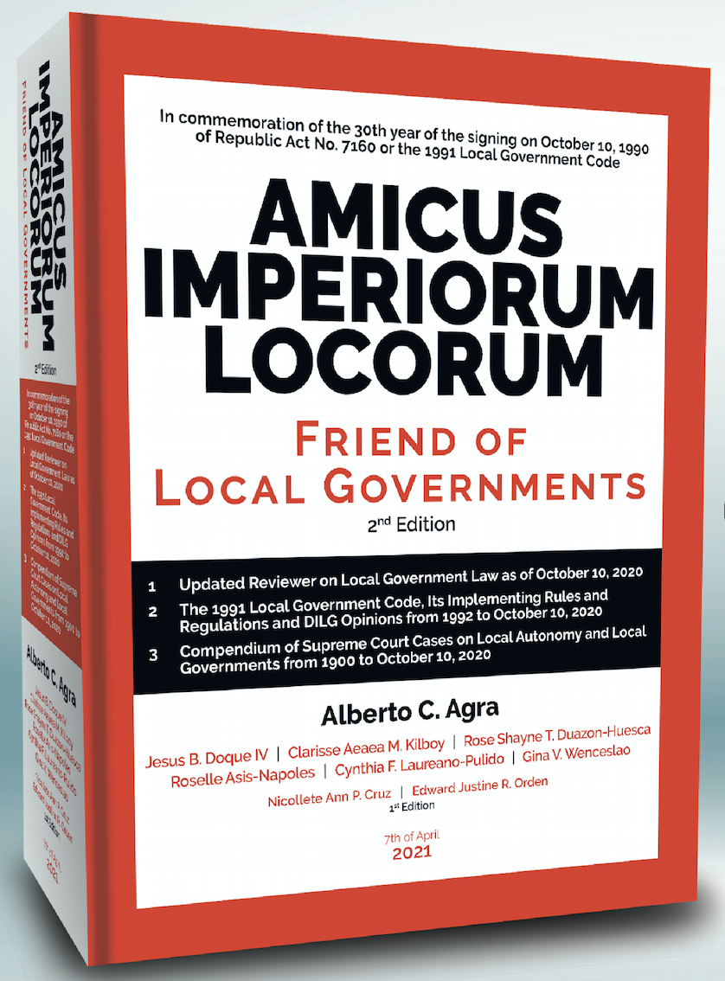

www.albertocagra.com
09175353823 alberto agra alberto.c.agra@gmail.com
Thank you.

